Slide 1
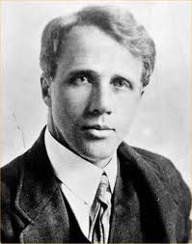
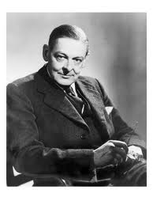
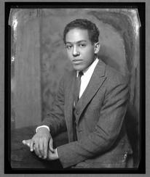
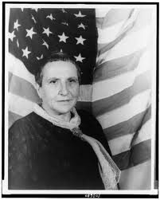
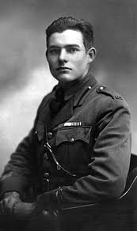
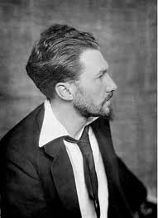
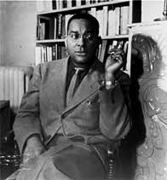
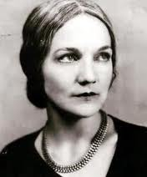
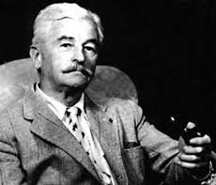
The Modern Period in American and British Literature Laura Álvarez Benítez

Slide 2
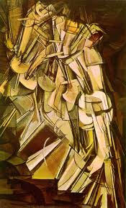
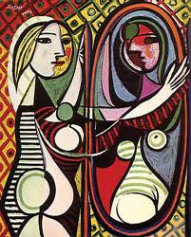
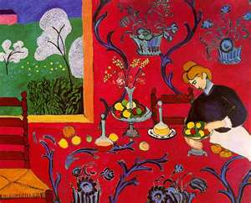
The events that took place during these tumultuous times had a deep and wide-ranging impact on aesthetic sensibility.
Artists felt that traditional art forms could no longer express the modern psychological state of dislocation, alienation, anxiety.

Slide 3
Literary Modernism’s most significant feature is:
Experimentation
Style
Subject Matter
The phrase “make it new,” attributed to Ezra Pound, became a rallying cry for writers who participated in this cultural movement

Slide 4
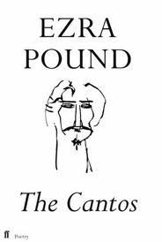
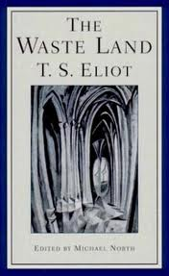
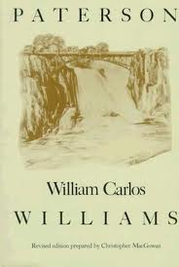
The Style of Literary Modernism.
Modernism’s literary forms are innovative and, often, challenging.
Writers were willing to disrupt traditional notions of order, sequence, and unity. They risked a certain amount of incoherence for the sake of experimentation.
Instead of predictable rhymes and forms, Modern poetry is sometimes chaotic, as if to mirror the randomness of modern life and to challenge the reader’s notion of order. Ezra Pound, William Carlos Williams, T.S. Eliot, and Gertrude Stein will give you a sense of Modern poetry’s experimentation with style

Slide 5
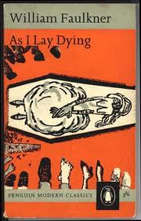
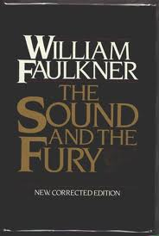
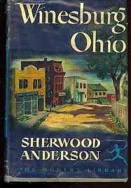
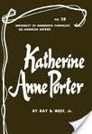
The Style of Literary Modernism
Stream of consciousness is a style that some Modern writers use to portray the inner workings of a character’s mind.
Writers catalog or describe the character’s thoughts, impressions, emotions, and ideas in rapid succession and without any interpretation or explanation by an outside narrator.
Writers who employ this style believe that it more accurately represents the confused and sometimes random jumps of the human mind.

Slide 6
The Subject Matter of Literary Modernism Alienation Existentialism Primitivism

Slide 7
Alienation
During the Modern period, many young British and American artists felt like outsiders within their own culture. It was difficult for them to come to terms with the unnecessary suffering and enormous loss of life caused by war. This helps explain why many Modernists experimented with their own styles, rather than tap into the traditional literary forms of their culture.
The pervasive sense of alienation that many writers felt led them to leave their countries and live in “voluntary exile” in other parts of the world. Often referred to as “expatriates,” writers as diverse as Gertrude Stein, Ernest Hemingway, T.S. Eliot, Ezra Pound, Robert Frost, Langston Hughes, and Sherwood Anderson spent years living abroad. In fact, some of them never returned home .

Slide 8
Alienation
“You are all a lost generation.”
-Gertrude Stein (quoted by Ernest Hemingway as an epigraph to his 1926 novel, The Sun Also Rises)

Slide 9
Existentialism
Many modernists rejected traditional philosophical and religious systems of belief in favor of Existentialism, which suggests a meaningless, chaotic, Godless world.
Existentialists believe that the individual has the sole responsibility for giving his/her own life meaning and living life passionately and sincerely, in spite of many obstacles and distractions including despair, angst, absurdity, boredom, and death.

Slide 10
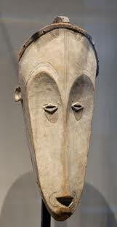
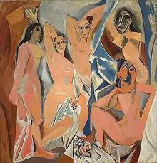
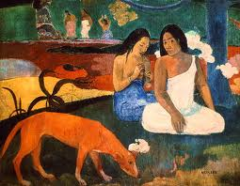
Primitivism
Modernists were inspired by Native American and African American art. The obsession with so-called “primitive” material and attitudes was fueled by an exploding interest in Freudian and Jungian psychology. Both Freud and Jung discussed “hidden,” subconscious motives, and the “primitive” appeared to offer a setting to explore their theories of psychology and sexuality.
The “primitive” was appealing because it seemed to represent a world unaffected by the constraints of modernity.

Slide 11
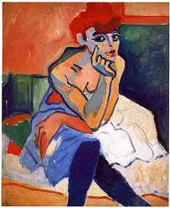
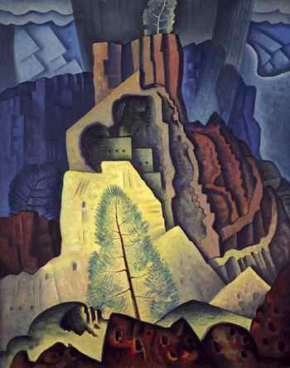
In conclusion, Modernism was a massive movement that included a broad range of authors, styles, and themes.
It was a revolt against the conservative values of Realism.
Modernism underscored the abstract, unconventional, largely uncertain ethic brought on by rapidly changing technology and dramatic cultural shifts.
Due to the richness of the art and literature produced during this time, it is sometimes referred to as the 20th Century Renaissance.
Due to the richness of the art and literature produced during this period, it is often referred to as the Twentieth Century Renaissance.

