Slide 1
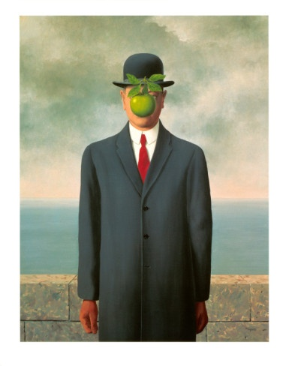
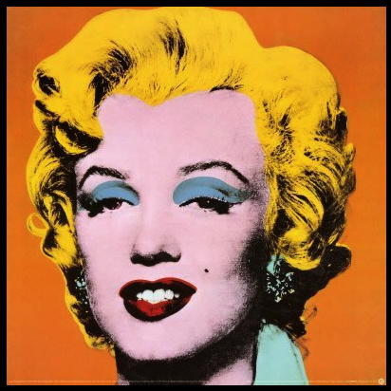
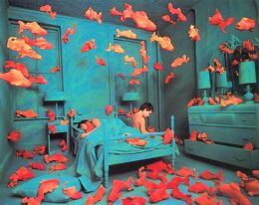
POST- MODERNISM IN LITERATURE

Slide 2
Definition: What is it?
It is the term used to describe the different aspects of Post –War WWII literature up to the present moment.
There is NOT a clear definition of the concept as it integrates different features and characteristics.

Slide 3
Main Features
Irony, playfulness, black humor Postmodern authors were certainly not the first to use irony and humor in their writing, but for many postmodern authors, these became the hallmarks of their style. Postmodern authors will often treat very serious subjects—World War II, the Cold War, conspiracy theories—from a position of distance and disconnect, and will choose to depict their histories ironically and humorously.

Slide 4
Main Features
Pastiche Many postmodern authors combined, or “pasted” elements of previous genres and styles of literature to create a new narrative voice, or to comment on the writing of their contemporaries.
Many postmodern authors, use elements from detective fiction, science fiction, and war fiction, songs, pop culture references, and well-known, obscure, and fictional history.

Slide 5
MAIN fEATURES
Intertextuality
An important element of postmodernism is its acknowledgment of previous literary works. The intertextuality of certain works of postmodern fiction, the dependence on literature that has been created earlier, attempts to comment on the situation in which both literature and society found themselves in the second half of the 20th century: living, working, and creating on the backs of those that had come before.

Slide 6
Main Features
Temporal distortion Temporal distortion is a literary technique that uses a nonlinear timeline; the author may jump forwards or backwards in time, or there may be cultural and historical references that do not fit: Abraham Lincoln uses a telephone in Ishmael Reed’s Flight to Canada. This technique is frequently used in literature, but it has become even more common in films.

